Slide 1
Gesture-Based Drone Control AeroMind System
AeroMind University of Alabama at Birmingham

Slide 2
PROBLEM
01
02
03
04
Complex Control
High Learning Curve
Drone controllers require training and are hard to use
New users struggle to operate drones safely
Unstable Gestures
Safety Risk
Gesture recognition is noisy and inconsistent
Wrong commands can lead to crashes

Slide 3
SOLUTION
Gesture Control
AI + Safety Layer
Hand gestures replace traditional controllers
Filters unstable commands before execution

Slide 4
System Architecture
Camera
Safety Layer
Captures real-time hand gestures
CONTROL FLOW
Filters unstable or unsafe commands
Detects and classifies gestures
Executes validated commands
Gesture Model
Drone

Slide 5
0.40
Command Dispatch Rate
0.60 Blocked Commands Safety layer filters unstable inputs

Slide 6
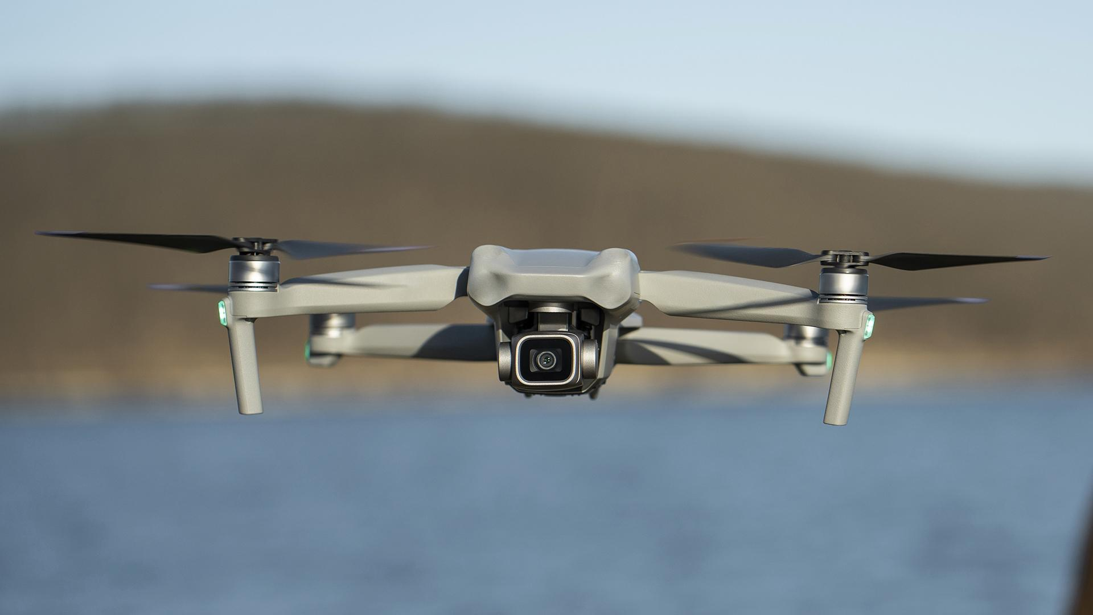
LIVE DEMO

